Slide 1
Day 7: Aggregations – GROUP BY, HAVING, Aggregate Functions
SQL Aggregate Functions
AVG Function
ANY_VALUE Function
COUNT Function
MAX Function
MIN Function
SUM Function
Grouping Rows
GROUP BY
HAVING
GROUPING SETS
ROLLUP
CUBE

Slide 2
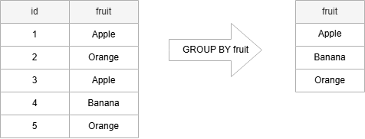
GROUP BY clause
SQL GROUP BY with INNER JOIN
SQL GROUP BY with HAVING
SQL GROUP BY with MIN, MAX, and AVG
SQL GROUP BY with SUM function
SQL GROUP BY multiple columns

Slide 3
HAVING clause
To filter groups, you use a HAVING clause
HAVING clause without a GROUP BY clause, the HAVING clause behaves like a WHERE clause.
HAVING vs. WHERE #
The WHERE clause applies a condition to rows before the rows are summarized into groups by the GROUP BY clause.
However, the HAVING clause applies a condition to the groups after the rows are grouped into groups.

Slide 4
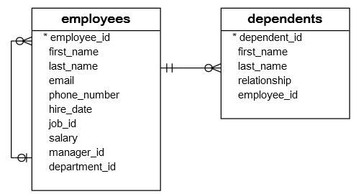
HAVING clause
HAVING with SUM function
HAVING with MIN function
HAVING clause with AVG function

Slide 5
GROUPING SETS
GROUP BY clause supports a single grouping.
To create multiple groupings within the same query use the GROUPING SETS
GROUPING SETS helpful in calculating subtotals and grand totals
To group data into multiple groupings GROUPING SETS

Slide 6
SQL ROLLUP
Generates hierarchical summaries.
It is used when one column is depends on another (State -> Job)
To return aggregated results at multiple levels of details, you use the ROLLUP with the GROUP BY clause:

Slide 7
SQL CUBE
Generate all possible combinations of groups

